Slide 1




Atmospheric Revelations
Exploring Exoplanet Composition and Structure through Innovative Instrumentation
Conor Earley¹
Dr. Nathaniel Butler²
Arizona Space Grant Symposium, April 2024
$^{1}$School of Earth and Space Exploration, Arizona State University
$^{2}$School of Earth and Space Exploration, Arizona State University

Slide 2
Overview
Introduction
Science objectives and background
Instrumentation
Current Endeavors
Outlook and Discussion

Slide 3
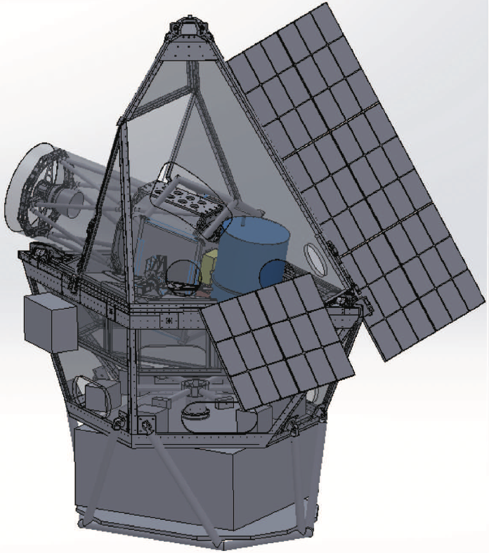
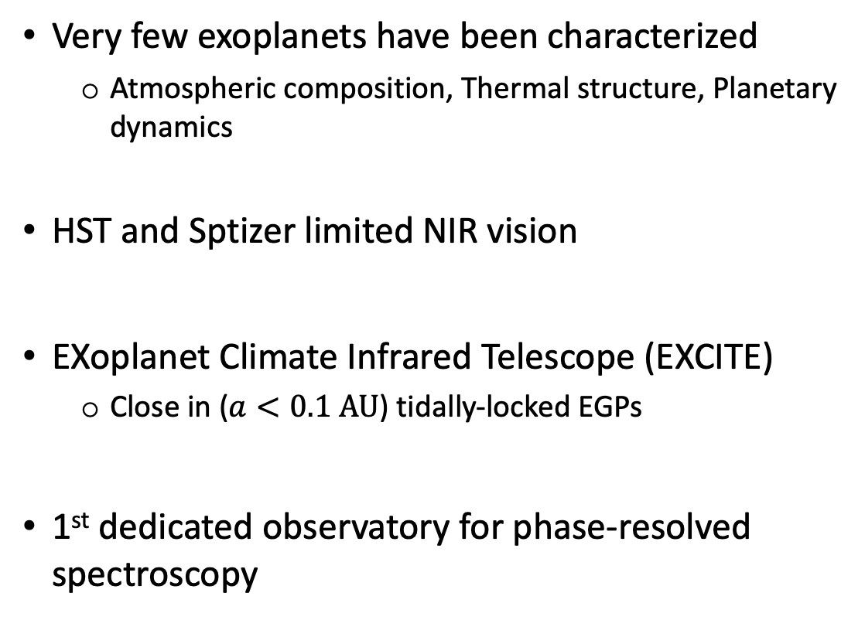
Introduction
Very few exoplanets have been characterized
  Atmospheric composition, Thermal structure, Planetary dynamics
HST and Sptizer limited NIR vision
EXoplanet Climate Infrared Telescope (EXCITE)
  Close in ($a<0.1 AU$) tidally-locked EGPs
1st dedicated observatory for phase-resolved spectroscopy
(Nagler)

Slide 4
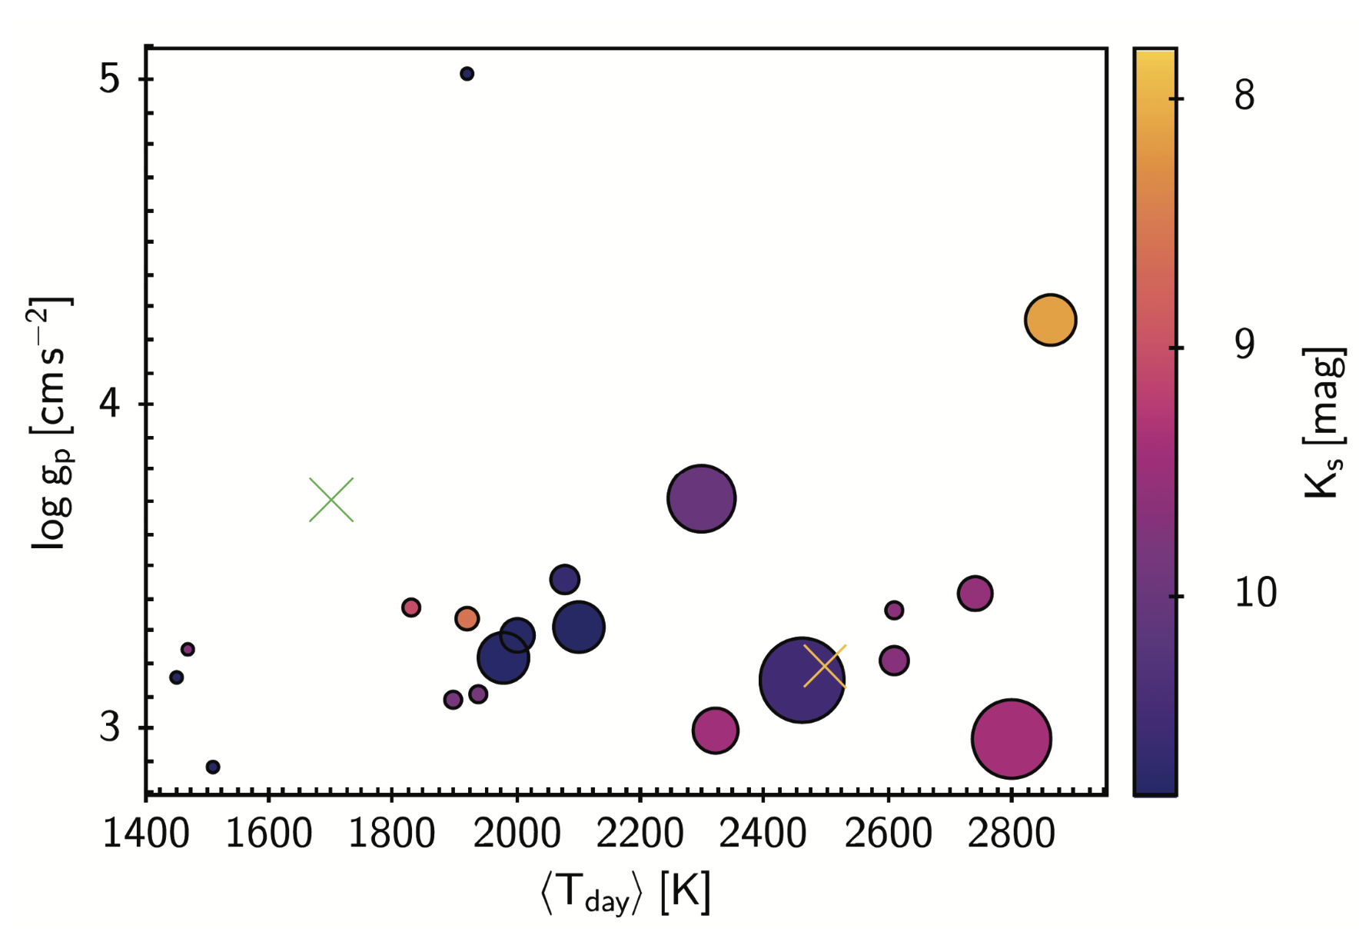
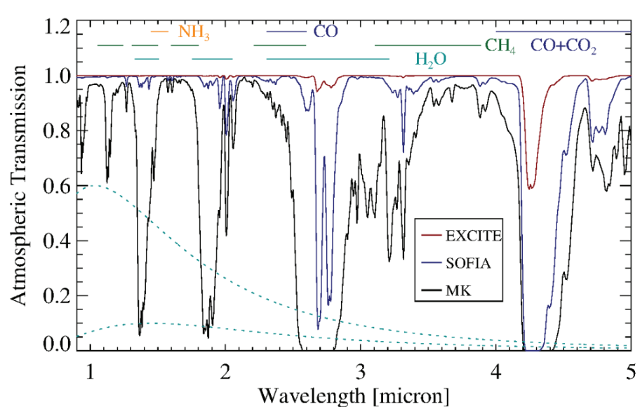
Science Objectives
Constrain global energy budget of hot Jupiters
Temperature distributions and atmospheric dynamics
Radiative and dynamical timescales
(Nagler)
First spectral classification of hot Jupiters
  M/L and L/T transitions
Chemical composition as function of longitude
(Nagler)

Slide 5
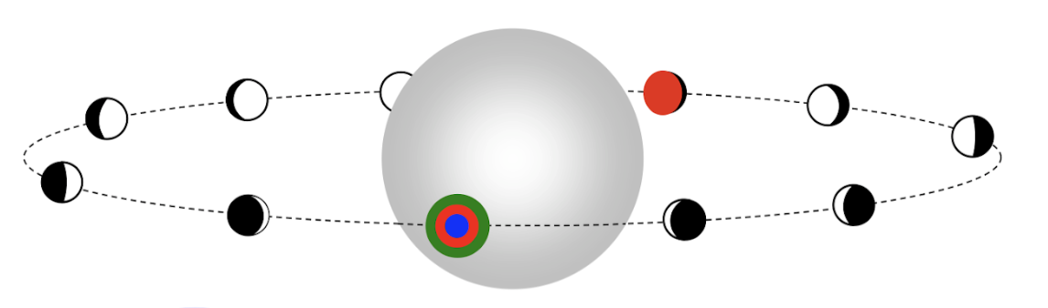
Phase-resolved Spectroscopy
(Line)
Observe EGP for full orbital period
Analyze spectral features through full phase
Transit spectroscopy
Phase-resolve spectroscopy

Slide 6
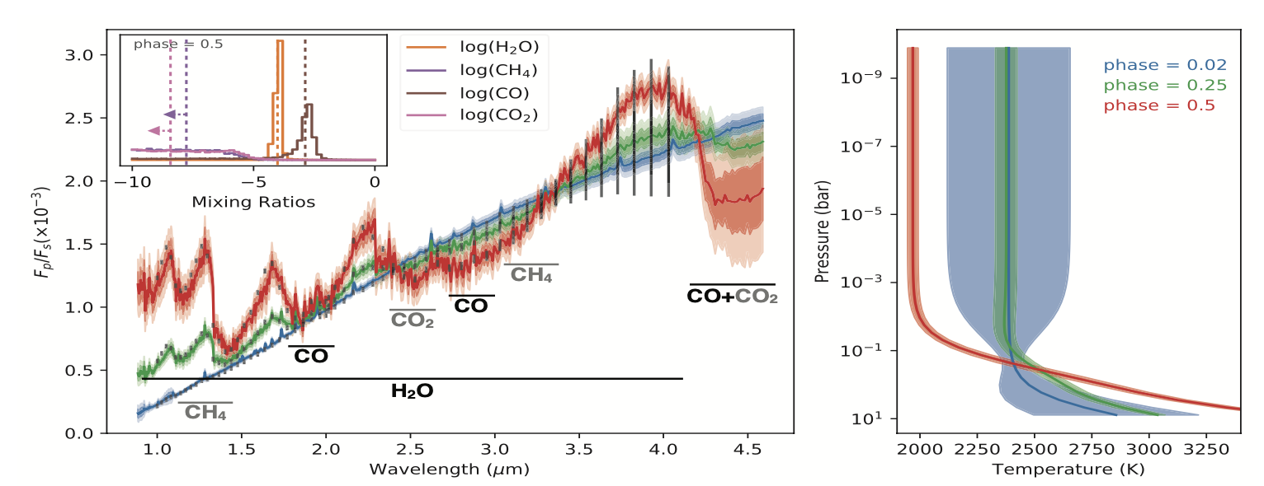
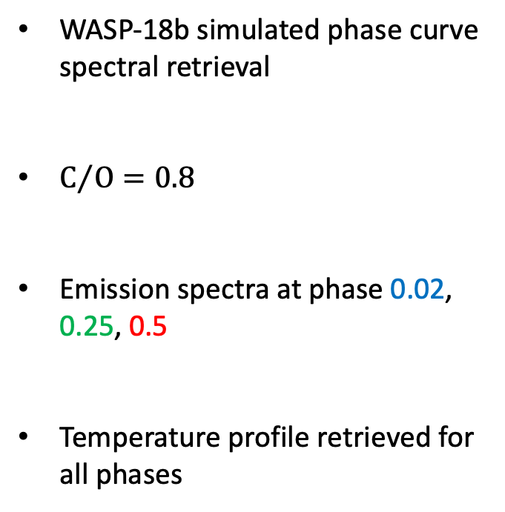
Phase-resolved Spectroscopy Background
WASP-18b simulated phase curve spectral retrieval
$C/O=0.8$
Emission spectra at phase 0.02, 0.25, 0.5
Temperature profile retrieved for all phases
(Nagler)

Slide 7
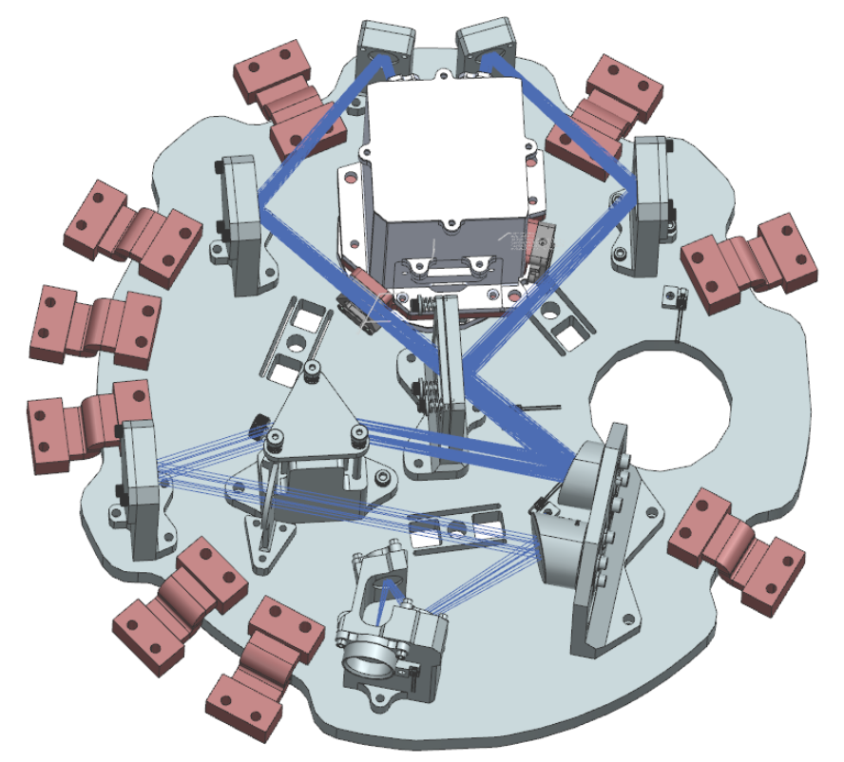
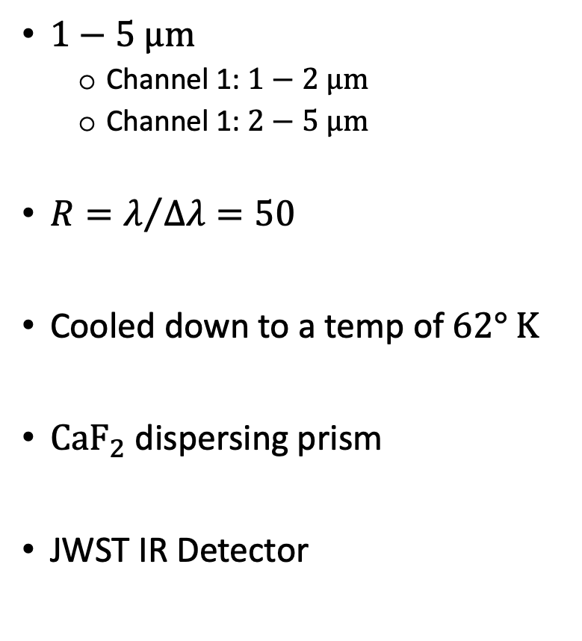
Spectrograph and Instrumentation
$1−5 μm$
  Channel 1: $1−2 μm$
  Channel 1: $2−5 μm$
$R=λ/{Δλ}=50$
Cooled down to a temp of $62° K$
$CaF_{2}$ dispersing prism
JWST IR Detector

Slide 8
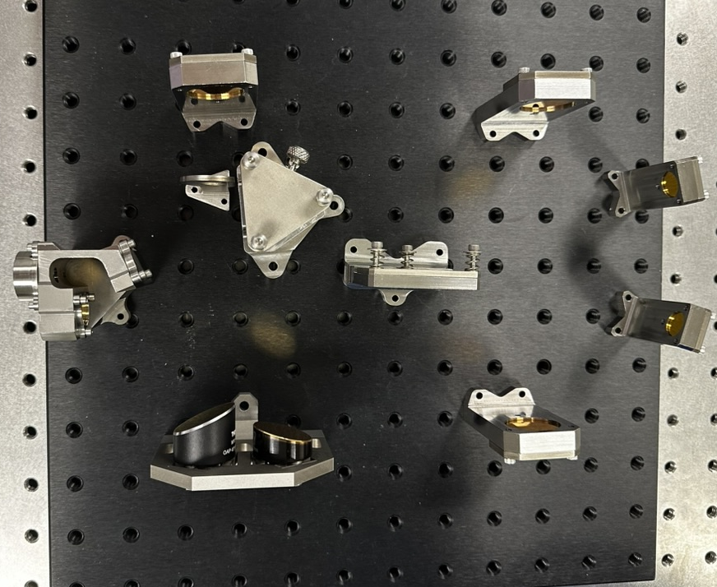
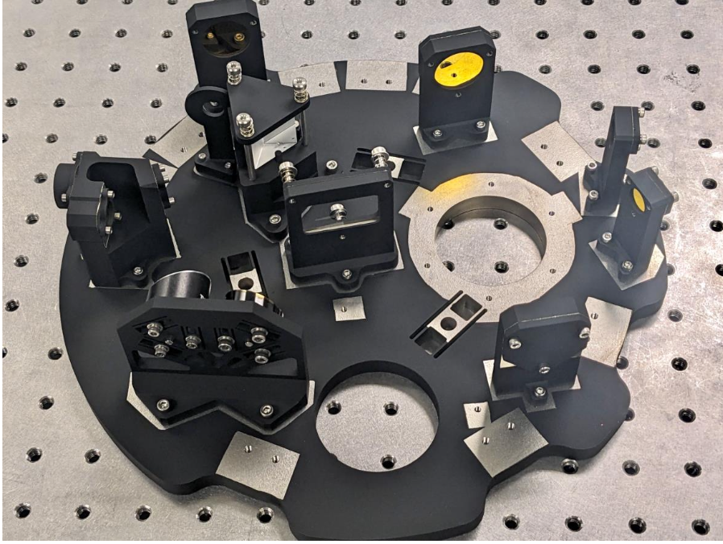
Spectrograph realization
Infancy
Completed
Engineering alignment and fully painted spectrograph
General layout to hone alignment procedures

Slide 9
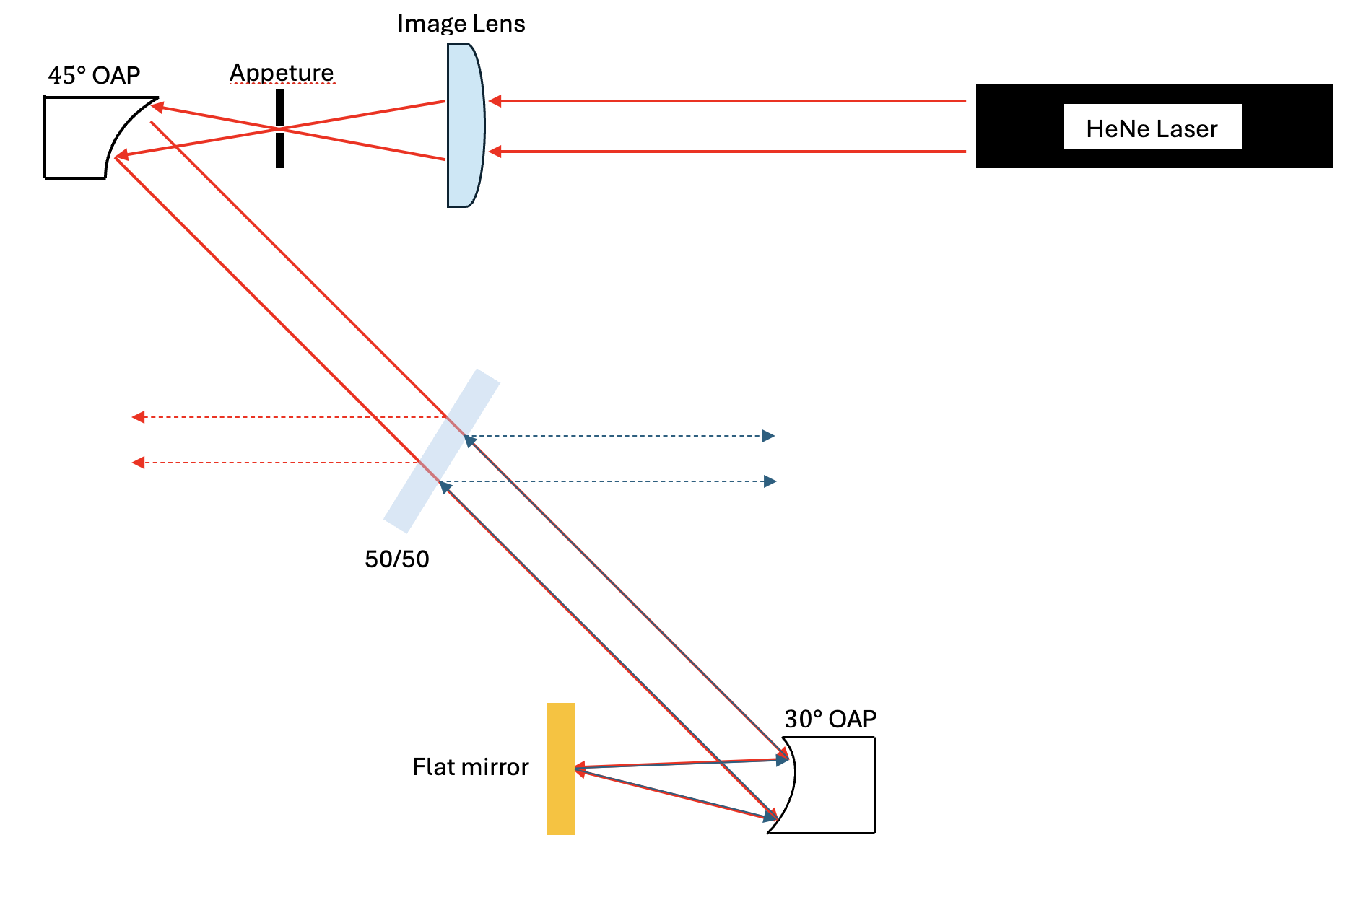
Current Endeavors - Optical Relay
Delivered spectrograph to Goddard in dewar
Engineering grade alignment
Simulating the two focal planes of detector
Generate alignment procedures to achieve scientific w/o removal from dewar

Slide 10
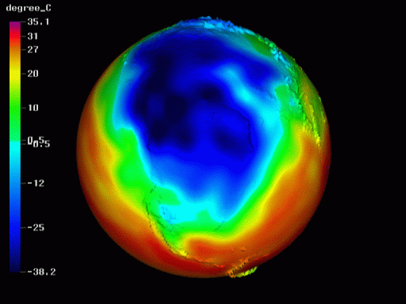
Outlook and Discussion
Engineering flight in August 2024 and hopefully an Antarctic in the upcoming years
Produce the first successful phase-resolved spectroscopic data
Simulate exoplanet’s atmosphere in a 3D GCM
Maximize JWST’s scientific output
(GENESIS)

Slide 11
Questions?

